Slide 1
Alpha Anywhere Q&A
March 16, 2022

Slide 2
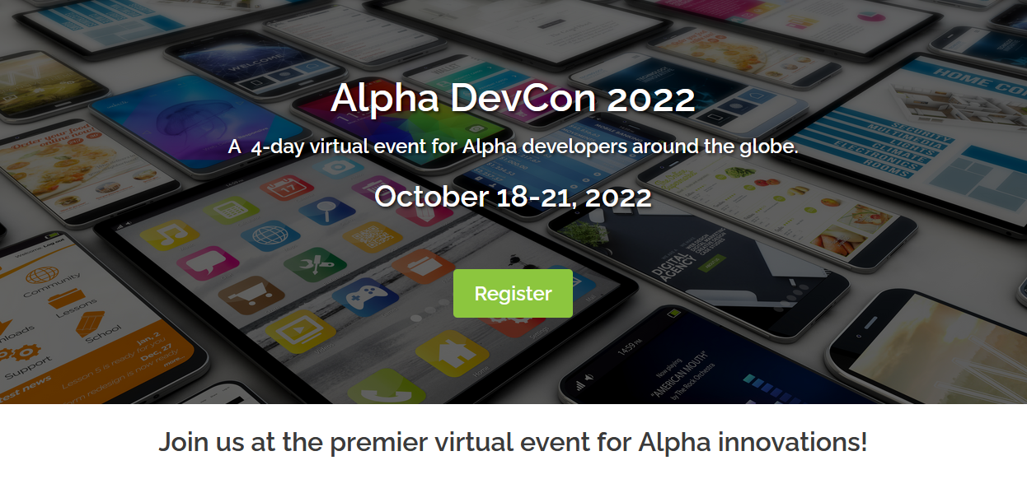

Slide 3

Register at www.alphasoftware.com/devcon2022

Slide 4

API Authentication Part 2
Limiting who can access what

Slide 5
What is Authentication
The act of proving an assertion
Example: Login
Username, Password, 2FA

Slide 6
Why Authenticate your APIs?
Limit who can access your API
Limit what someone can access in your API
Rate Limiting
Auditing

Slide 7
Authentication Methods
Basic/Bearer Authentication
API Keys
Oauth (2.0)

Slide 8

API Key Authentication
User request and API Key from your system
You provide a key they then use on all request
API key proves they are permitted access

Slide 9
HTTP Status Codes
Five Types:
1xx: Informational – Communicates transfer protocol-level information.
2xx: Success – Client’s request was successful.
3xx: Redirection – Client must take additional action to complete the request
4xx: Client Error – The client did something wrong
5xx: Server Error – You did something wrong

Slide 10

Key Status Codes
200 Success - API Call successful
400 Bad Request - Requst is incorrect
401 Unauthorized - Authentication required but missing
403 Forbidden - Not authorized
418 I'm a teapot - Tried to brew coffee using a teapot

Slide 11

Previously
Generated and tested a Web Service for our data
Created a component for handling API Key request
Generated key using simple UUID

Slide 12

Today
Clean-up key generation
Implement key authentication

